Slide 1
Issues Working Team T-1A Progress from last ad-hoc meeting
ISO & GeoDCAT-AP Pilot – 2nd Meeting - Phase 2, 7 July 2026
Jordi Escriu (JRC)

Slide 2
Prioritised issues

Slide 3
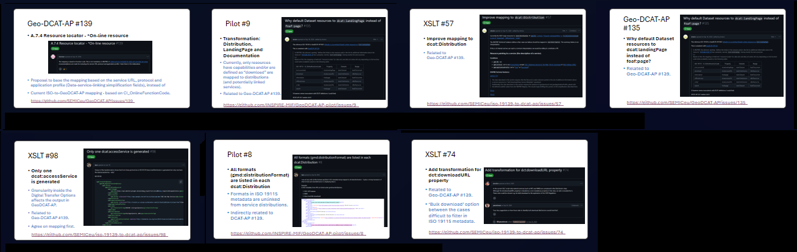
Open issues - Work ongoing, tackled by T-1B
Issues directly or indirectly in the scope of the T-1B mapping proposal presented today
Community feedback needed: Open for feedback and review until 15 September.

Slide 4
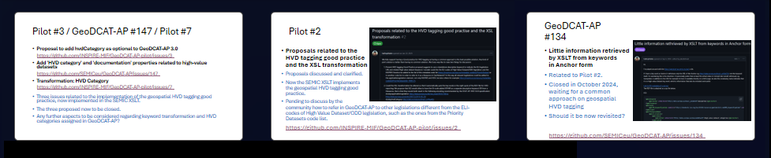
Closed / Resolved issues
HVD-tagging Good practice

Slide 5
Less prioritised issues

Slide 6
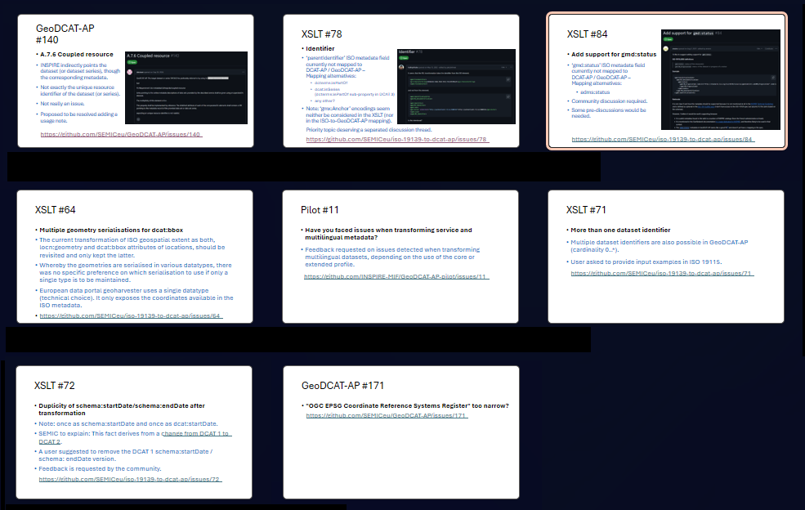
Issues to be tackled in next T-1A meeting
For the next ad-hoc T1-A meeting (September)
Together with newly appeared issues

Slide 7
Discussion / Next steps
Active discussion is foreseen on the Mapping proposal from T-1B presented today
Scoped to the most burning issues
On services and APIs descriptions / distributions
Open for feedback and review until 15 September
Need consensus for implementing changes to the SEMIC XSLT
Activity on the GitHub repositories is low
How to engage the community to reactivate discussions and ensure resolution of key issues?

